Slide 1
Documentation and Billing

Slide 2
EMS Documentation Uses
Legal record
Continuity of care with hospital
Internal quality assurance
Billing record
Notes:
When you document an incident, you are writing for several different audiences. There’s the legal audience—the number of records requests we receive from attorneys continues to grow. There’s the patient care audience—hospitals and nursing homes that coordinate their care with yours. And then there’s your chief or MSO who is going to review your documentation, and you definitely want to keep them happy. Today we’re going to look more in depth at how your documentation is used for reimbursement.

Slide 3
Today’s Environment
Government focus on fraud
Increased audits
Legally collecting every dollar
EHR—privacy vs. access
Increased litigation
Notes:
What is happening in the current environment that makes documentation so important?
Health care fraud is mentioned everywhere from daily news to state of the union address. This has produced all kinds of new audits—and ambulance claims are not exempt.
Your documentation is key to proving that an ambulance was necessary and proving the level of service you provided. If it wasn’t documented, it didn’t happen. Another big government push is for electronic medical records by 2015. Access to your patient’s pertinent medical history is a welcome addition and brings with it more HIPAA privacy issues. And we Americans love to sue each other—it’s almost impossible to be involved in an auto accident and NOT have an attorney involved.

Slide 4
Important Areas
Dispatch
Medical Necessity and Reasonableness
Why was an ambulance needed?
What was the level of service provided?
Mileage
Destination
Forms
Notes:
When we receive transport information for billing, there are some specific areas that we look at and they are listed here:
Dispatch information--we’re looking at emergency vs. non-emergency
Necessity—the narrative is very important to show why an ambulance was needed and what level of service was provided.
Mileage—new rules
Destination—not all destinations are covered by all payers.
Forms—we’ll touch on patient signatures and EMT signatures.
As we look at documentation, we’re really going to be talking about Medicare’s standard for each of these areas. Their standard is the most comprehensive—if you document to the Medicare standard for all your patients, you will be in great shape!

Slide 5
Dispatch
Notes:
First up is dispatch information.

Slide 6
Dispatch Documentation
“Emergency” status:
How were you dispatched
How did you respond
Reported condition of patient
ALS assessment
Example: Dispatched 911 and responded immediately to report of difficulty breathing
Notes:
Part of determining the level of service is whether a transport is emergency or non-emergency. Your agency might deal mostly in emergency calls but the claims office in Fargo, North Dakota does not know that, so you should document it. Medicare has 2 criteria to bill at the emergency level. 1. The dispatch must be through a 911 or equivalent system and 2. The response must begin as quickly as possible. This can be documented very concisely, as in the example.
Going back to the second bullet, you should document the patient’s reported condition here--we’ll get to why when we look at ALS and BLS levels of service.

Slide 7
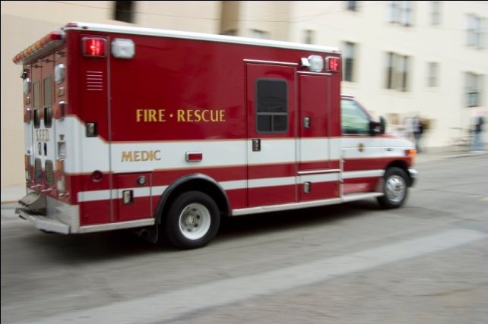
Dispatch Documentation
Date and time
Point of pick-up with zip code
Payment based on pick-up location
Notes:
Date and time are particularly important when the patient is transported twice in the same day—the second transport is almost always denied. When we appeal, the PCR needs to be able to prove that there were 2 separate transports.
The pick-up location zip code is an odd request. Why is it needed? The zip code determines the fee schedule used to pay claims as well as whether the urban or rural bonus would apply. Medicare is a bit picky about this—what if you documented the wrong zip code and received a larger payment than you should have? Medicare considers that fraud.

Slide 8
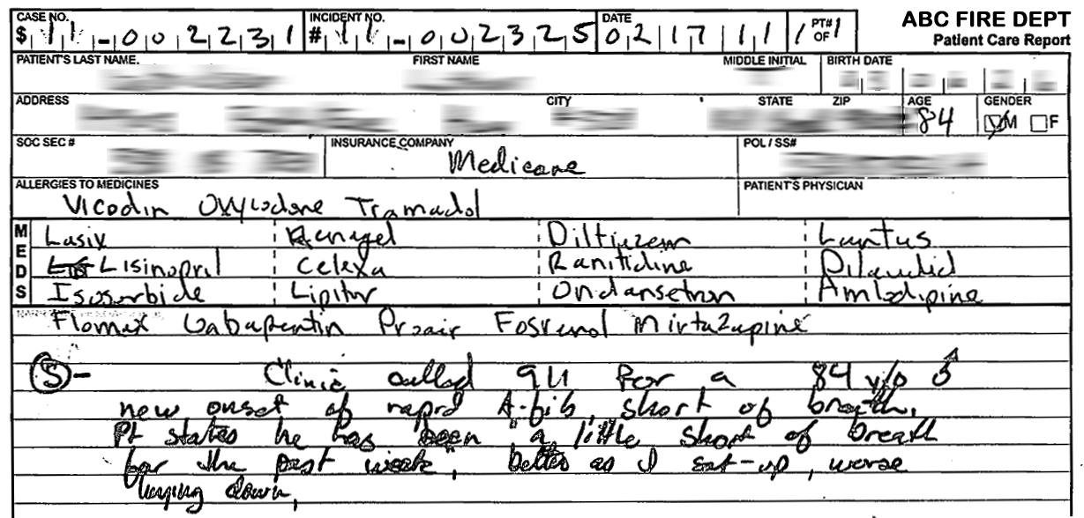
Notes:
Here’s an example of a transport. You can see the transport date and the dispatch states it was a 911 response. You also have the patient’s reported condition.

Slide 9
Medical Necessity
Definition of medically necessary:
Transport by any other means is contraindicated
Document why an ambulance was needed
Medicare will only pay for medically necessary transports
Notes:
Medicare will only pay for transports that are medically necessary. And that makes a certain amount of sense—you don’t want patients using an ambulance because they have a doctor appointment at the clinic and they just want to be dropped off at the front door. But where do you draw the line?
Here is Medicare’s definition of medical necessity--an ambulance is necessary when transport by any other means is contraindicated. What does that mean? If the patient could have traveled safely by another means, the ambulance was not necessary.
The narrative section is the main area where you prove medical necessity—you have to paint a picture that’s clear to the claims office in Fargo—why an ambulance was needed.

Slide 10
Medical Necessity
Medical necessity is presumed if the record adequately documents one or more of the following:
Unconscious or in shock
Hemorrhage
Acute stroke or myocardial infarction
Accident or injury or acute illness
Notes:
The next 2 slides show the list of patient conditions that Medicare will accept as medically necessary. If a patient displays any of these conditions, be sure it is documented in the PCR.

Slide 11
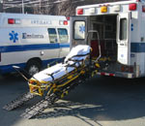
Medical Necessity
Immobilization of possible fracture
Required oxygen (not self-administered)
Required emergency measures or treatment
Required restraints
Stretcher required
Bed confined
Notes:
This is an example of medically necessary documentation that was missing and caused the claim to be denied.
The 911 call and the transport was for a patient with a bladder infection. There was nothing on the PCR that could show the transport was medically necessary so the claim was denied, even on appeal. This happened to be a patient that was transported often and was well known to EMS personnel. As we reviewed other transports, we found that the patient had MS and was bed confined.
It can be extra challenging to document patients who are well-known to your agency. It can feel like you are repeating yourself and stating the obvious, but just remember that the person in Fargo who might end up reading this one report does not know the same information. Each incident should be able to stand alone.

Slide 12
Documentation Goals
Provide accurate information on the patient’s condition and your findings
Provide sufficient information for a proper billing decision to be made
Notes:
Not every transport will be medically necessary. You’ve probably had that patient who comes out of the house with suitcase in hand and meets you in the driveway. Document thoroughly and accurately on the patient’s condition and if it turns out to be not medically necessary, so be it! There will be cases where we will not be able get payment from insurance and will have to seek payment from the patient.

Slide 13
Bed Confined
Definition: All 3 must be true!
Unable to safely get out of bed; and
Unable to safely ambulate; and
Unable to safely sit in a chair
Example: Pt unable to get out of bed or ambulate without assistance due to extreme vertigo and was unable to sit unassisted…
Notes:
Here’s a little bit more information on how Medicare defines bed confined. When documenting, just noting “Patient is bed-confined” is not thorough enough. Medicare is looking for a description of the patient’s condition, as in the example.

Slide 14
Documenting Level of Service
BLS
ALS 1
ALS 2
Specialty Care
Deceased on scene
Notes:
There are the basic levels of service.

Slide 15
BLS
Service can be emergency or non-emergency
EMT-B level of care
Often harder to document than ALS
Notes:
It can be more challenging to show medical necessity on BLS transports. Keep asking yourself “Why does this patient need an ambulance?” and document those reasons.

Slide 16
ALS-1
Patient condition requires EMT-I or EMT-P interventions
Document your assessment and interventions
ALS dispatch downgraded to BLS transport
Dispatch documents ALS crew required
ALS crew provides a hands-on assessment
Notes:
ALS can also be emergency or non-emergency. When dispatch information requires an ALS crew, they respond, treat the patient and transport. Be sure to document all interventions—IV’s, labs and your assessment.
You can occasionally bill ALS-1 when an ALS call is downgraded to BLS. The dispatch information must show that an ALS crew was required to respond and the ALS crew must provide a hands-on assessment, documented and signed. BLS crew can then transport the patient and the transport can be billed at the ALS level.

Slide 17
ALS-2
Same as ALS-1 plus any ALS-2 procedure
Manual defib/cardioversion
Endotracheal intubation
Central venous line
Cardiac pacing
Chest decompression
Surgical airway
Intraosseous line OR…
Notes:
There are 2 ways to qualify for an ALS-2 level transport. Any one of these procedures qualify as ALS-2.

Slide 18
ALS-2
Same as ALS-1 plus 3 or more IV medications
Must be 3 separate full doses of one drug, or
3 different drugs
Notes:
…or, administering 3 or more IV medications. The dose must be the full dose of the medication—taking one dose and dividing it into 3 separate doses would not count.

Slide 19
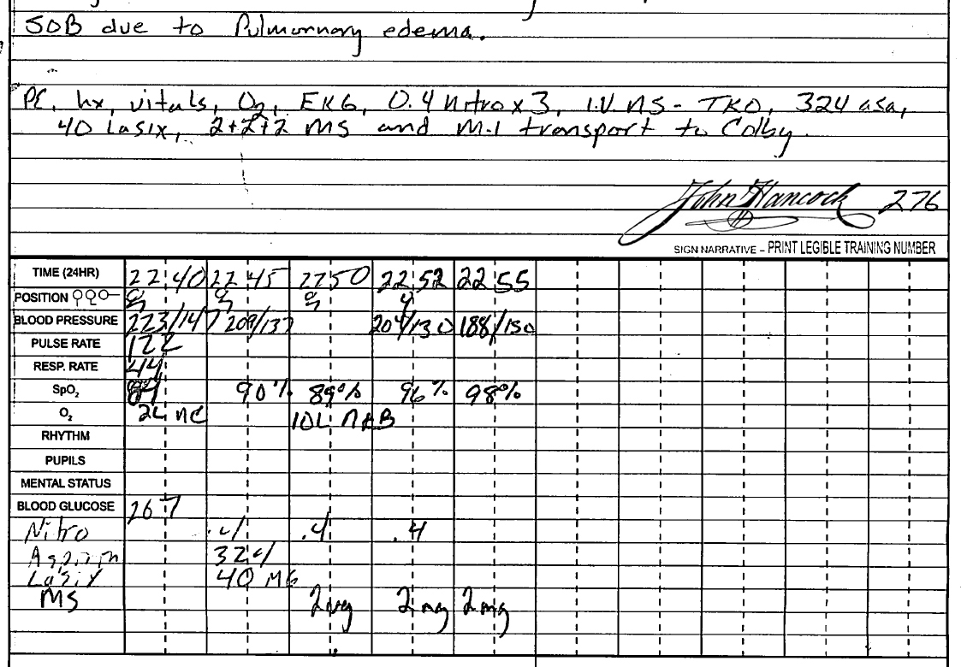
Notes:
The medication must be administered IV to count as one of the 3. Nitro and ASA do not count.
Also excluded are solutions such as Dextrose, normal saline, ringer’s lactate—any crystalloid, hypotonic, isotonic and hypertonic solutions do not count.
This is nicely documented—good flow chart and documented in the narrative as well. You could add how the drugs were administered.

Slide 20
Specialty Care
Interfacility transport
Patient is critically ill or injured
Service level is beyond the scope of EMT-P
Notes:
Specialty care transport—this level of service is reimbursed at the highest level paid by Medicare. Here are the requirements—it must be an interfacility transport—it’s usually from one hospital to another for a higher level of care. Patient must be critically ill or injured and someone with training above the scope of a paramedic needs to be on board. This is often a nurse or staff from an air ambulance. It can also be a paramedic who has received state-approved additional training.

Slide 21
Deceased on Scene
BLS level of service can be billed if:
Patient was pronounced deceased after dispatch
Patient was not transported
Notes:
Generally, the Medicare benefit for ambulance is a transport benefit—if you aren’t transported, Medicare does not pay. This is the one exception to that rule. If you are dispatched to a scene and the patient is pronounced deceased before being loaded into the ambulance, you can bill at the BLS level of service. No mileage is billed for this service.

Slide 22
Mileage
Only charge for loaded miles
New fractional mileage rules
Acceptable documentation
Odometer readings
Trip odometer
GPS device
Medicare pays to closest appropriate facility
diverted
Notes:
Mileage billed should be loaded miles only, in most cases from the scene to the hospital. You can’t bill for miles from the station to the patient.
As you know, the mileage rules have just changed so that mileage must be measured to the tenth of a mile. The gold standard for measuring miles is odometer readings. You would show the odometer reading at the scene and then again at the destination. Some ambulance vehicles do not have odometers that measure to tenths, so trip odometers and GPS devices are also acceptable.
Another mileage rule is Medicare will only pay to the nearest appropriate facility. They tend to look at this regionally, so you can choose from the hospitals in your region.
If you are transporting outside your normal region, you will want to document why. You should also document any time you are diverted to a different hospital.

Slide 23
Destination
Name of hospital/facility
Limit abbreviated names
Destinations that are not payable:
Physicians office
Rendezvous with another ground ambulance
Notes:
Our claims going to Medicare need to list the receiving facility. Sometimes abbreviations can make it hard to figure out the correct hospital. Harrison Hospital in Bremerton might end up with the same abbreviation as Harborview Hospital in Seattle, so clearly documenting the hospital is advised.
If you are taking a patient to a physician’s office or for dialysis or some kind of treatment that is not in a hospital, please document it clearly. If we assume a destination is a hospital but it really is a doctor’s office, we might send out incorrect billing and receive payment for something that should not have been paid.
This question sometimes comes up when there is snow—maybe the patient is in a wheelchair and they have scheduled a cabulance to transport them but then the snow comes. The cabulance cancels the transport and suggests that the patient call 911. If the patient is covered by Medicare, it will not be paid.
Rendezvous or multiple ground agencies responding—Medicare will only pay to one ground agency.

Slide 24
Forms
Patient signature
Hospital face sheet
EMT Signature
Physician Certification Statement (PCS)
Advanced Beneficiary Notice (ABN)
Notes:
Getting a patient signature and hospital face sheet at the time of transport goes a long, long way to getting prompt payment.
In the last year, the rules on EMT signatures have gone through some changes. The same signature rules that are used for physicians and nurses are now also being applied to EMTs. The PCR needs to be signed by the EMT. If you have really wonderful handwriting, then just your signature is fine. If you are like most people and no one can tell what that little scribble says, be sure to legibly print your name underneath your signature.
Here’s how the EMT signature is used at Medicare. If Medicare denies a claim, we write an appeal and send in the PCR to show what was documented at the time of the transport. If the “Providers” signature (the EMT) is not legible or it is not signed, nothing from the PCR can be considered in the decision. So these have become much more important in 2010.
The Physician Certification Statement is used for non-emergency, inter-facility transports. If your agency does this type of transport we can work through the requirements with you.
The Advanced Beneficiary Notice is only used in non-emergency transports and is helpful when you have a transport that you know will not be paid by Medicare. An example is when a patient chooses to go to a different hospital or nursing home for purely personal reasons. It puts the patient on notice that they will be responsible for the bill.

Slide 25
Documentation and Billing
Systems Design
Thank You!

